Slide 1
Arrays
Object Oriented Programming
AAPP013-4-2
Copyright 2016 Asia Pacific Institute of Information Technology

Slide 2
Topic & Structure of the lesson
Arrays
Array basics
Simple Array processing loops
One-Dimensional Arrays
Examples of Array Programs
Sorting
Searching
Slide <number> of 36
Notes:
<number>

Slide 3
Learning Outcomes
At the end of this topic, you should be able to:
Define, initialise and access array data types
Write Java programs using arrays
Slide <number> of 36
Notes:
<number>

Slide 4
Key Terms you must be able to use
If you have mastered this topic, you should be able to use the following terms correctly in your assignments and exams:
array
Slide <number> of 36
Notes:
<number>

Slide 5
Array Basics
Definition
An array contains a fixed number (called its length) of variables of identical type.
In Java, it is a specialized kind of object and it must be declared in 2 steps :
1. Declare the object :
type[] array_name;
Eg. int[] counts;
double[] scores;
Time[] appointmentTime;
Slide <number> of 36

Slide 6
Array Basics
2. Allocate the object :
array_name = new type [size];
Eg. counts= new int[10];
scores= new double[15];
appointmentTime = new Time[10];
Combination of 2 steps :
type [] array_name = new type [size];
Eg. int[] counts = new int[10];
Slide <number> of 36

Slide 7
Array Basics
The bracketed no. is the length (which states how many variables in each array.
0 1 2 3 4 5 6 7 8 9
} index / subscript
counts
int variables
Arrays can contain any type of value : simple values or
references to objects
To obtain a specific variable, we use subscripts, for eg.
Slide <number> of 36

Slide 8
Array Basics
counts[0] // the first variable in counts
counts[1] // the second variable in counts
counts[9] // the last variable in counts
counts[10] // error : ArrayIndexOutOfBounds
Each of these subscripted arrays is an int variable and can
be used in the same ways that any int variable is used.
Slide <number> of 36

Slide 9
Array Basics
Example 1 :
Write and run a program that read 10 integers and print
it in reverse order.
Sample program :
Slide <number> of 36

Slide 10
Array Basics
Sample program:
class Simple {
public static void main (String[] arg) {
int[] counts = new int[10];
Scanner input = new Scanner(System.in);
System.out.print("Enter ten numbers: ");
counts[0]= input.nextInt();
counts[1]= input.nextInt();
counts[2]= input.nextInt();
counts[3]= input.nextInt();
counts[4]= input.nextInt();
counts[5]= input.nextInt();
counts[6]= input.nextInt();
counts[7]= input.nextInt();
counts[8]= input.nextInt();
counts[9]= input.nextInt();
System.out.print(counts[9] + " " + counts[8] + " " + counts[7] + " " + counts[6] + " " + counts[5] + " " + counts[4] + " " + counts[3] + " " + counts[2] + " " + counts[1] + " " + counts[0] + "\n");
}
}
Slide <number> of 36

Slide 11
Array Basics
Array Features To Be Noted:
Array subscripts can be expression, not just constant.
Eg.
counts[1] // constant array subcript
counts[i]
counts[i*2]
counts[i/2]
}
array subcript in expression form
Slide <number> of 36

Slide 12
Array Basics
Arrays can be initialized by giving a list of all their elements :
int[] primes = { 2,3,5,9,11,13,17,19,23,29 };
However, this can only be used at the time the array is declared. Thus,
int[] prime;
primes = { 2,3,5,9,11,13,17,19,23,29 };
}
ILLEGAL
Slide <number> of 36

Slide 13
Array Basics
Array Features To Be Noted (cont’d) :
The above method can also be used to initialized an array of Strings such as :
final String NAME[] = { “”, “Sunday”, “Monday”, “Tuesday”, “Wednesday”, “Thursday”, “Friday”, “Saturday”};
int day=1;
void printName (int day) {
while (day <=7) {
System.out.print( NAME[day] );
day++;
}
}
Slide <number> of 36

Slide 14
Array Basics
Java’s array have an important instant variable : length, which tells the no of elements in the array.
while (day <= NAME.length) {
System.out.print( NAME[day] );
day++;
}
Slide <number> of 36

Slide 15
Simple Array Processing Loops
Now, let’s use for loop to generate the subscript of an array.
for (int i=0; i<10; i++)
count[i] = i*10;
or, we can use array’s length instance variable
for (int i=0; i<count.length; i++)
count[i] = i*10;
0 1 2 3 4 5 6 7 8 9
counts
0 10 20 30 40 50 60 70 80 90
Slide <number> of 36

Slide 16
Simple Array Processing Loops
Example 2 :
Write a more concise program for the “Simple Program”.
Sample program :
class Simple2 {
public static void main (String[] arg) {
int[] counts = new int[10];
Scanner input = new Scanner(System.in);
System.out.print("Enter ten numbers: ");
for (int i=0; i<10; i++)
counts[i]=input.nextInt();
for (int i=0; i<10; i++)
System.out.print(counts[10-i] + " ");
System.out.println();
}
}
Slide <number> of 36

Slide 17
Modular Programming Example
Example 3 :
Encapsulate the reading & echoing of an array in a class called Collection :
Sample program :
The Main Program
(The Client)
It can instantiate a Collection Object, providing a large no. as an argument to the constructor.
class Main {
static final int INPUT_MAX = 1000;
public static void main (String[] arg) {
Collection c = new Collection(INPUT_MAX);
c.readAndEcho();
}
}
Slide <number> of 36

Slide 18
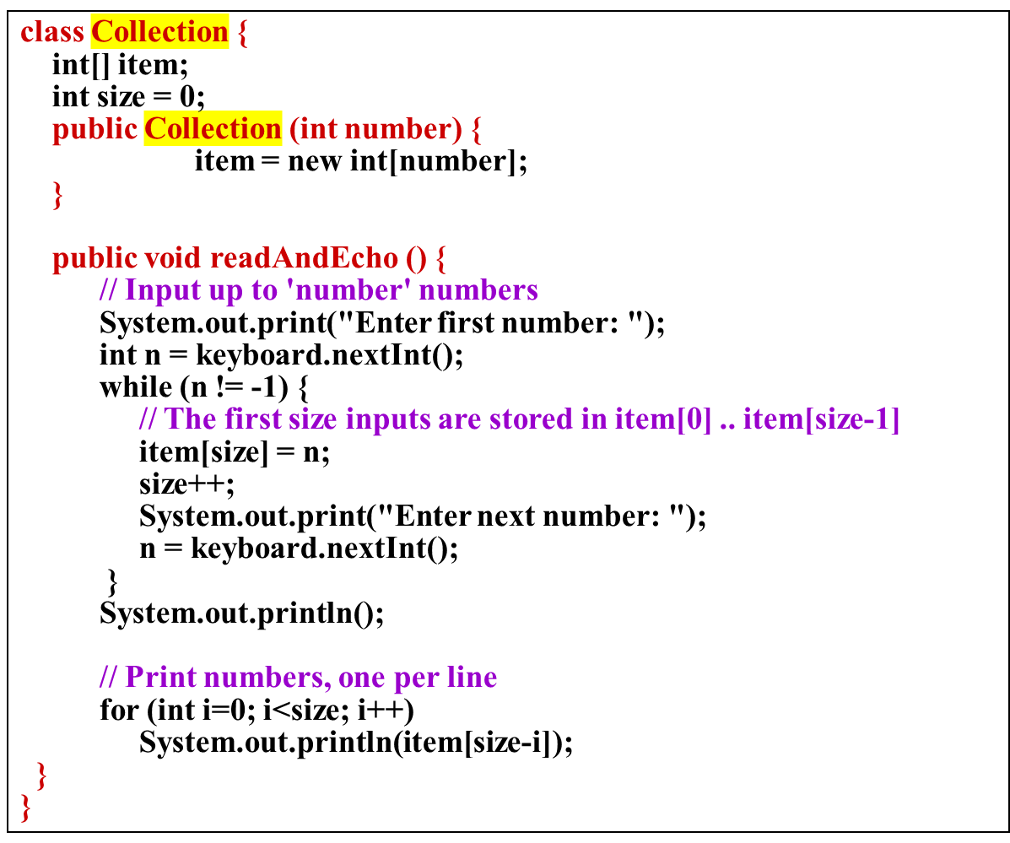
Modular Programming Example
Collection class
Slide <number> of 36

Slide 19
Modular Programming Example
Write a program, which reads a sequence of student names and
scores on 2 exams and prints a listing giving the average score
for each student. The input for each student is in the form of a
name (String) and 2 numbers.
Sample run of the program :
Enter name and two exam grades : Clark Kent
57
69
Enter name and two exam grades : Lois Lane
94
86
Enter name and two exam grades : Jimmy Olsen
90
97
Enter name and two exam grades : q
Name Average
Clark Kent 63
Lois Lane 90
Jimmy Olsen 83
Slide <number> of 36

Slide 20
Modular Programming Example
Main Program
class GradeBook {
String[] names, x;
int[] exam1, exam2;
int size = 0;
public GradeBook(int number) {
names = new String[number];
exam1 = new int[number];
exam2 = new int[number];
}
public void readAndAverage() {
// Read names and exam grades; size counts inputs
while (true) {
System.out.print("Enter name and two exam grades: ");
names[size] = keyboard.nextLine();
if (names[size].equals(“q”)) break;
exam1[size] = keyboard.nextInt();
exam2[size] = keyboard.nextInt();
x=keyboard.nextLine();
size++;
}
System.out.println();
System.out.println("\tName\tAverage");
for (int i=0; i<size; i++) {
System.out.println("\t" + names[i] +
"\t\t" + (exam1[i] + exam2[i])/2); }
}
}
class ReadAndAvg2 {
static final int INPUT_MAX = 100;
public static void main (String[] arg)
{
GradeBook grades = new GradeBook(INPUT_MAX);
grades.readAndAverage();
}
}
Gradebook class
Slide <number> of 36

Slide 21
Modular Programming Example
A better structure for GradeBook would be define a class of
objects representing students ~ including their names and grades
and construct an array of these objects.
class Student {
private String name;
private int exam1, exam2;
public Student () {}
public void setName (String s) { name = s; }
public void setExam1 (int s) { exam1 = s; }
public void setExam2 (int s) { exam2 = s; }
public String getName () { return name; }
public int getExam1 () { return exam1; }
public int getExam2 () { return exam2; }
public int getAvg () { return (exam1+exam2)/2; }
}
Student class
Slide <number> of 36

Slide 22
Modular Programming Example
class GradeBook {
Student[] students; int size = 0;
public GradeBook(int number) {
students = new Student[number];
}
public void readAndAverage() {
// Read names and exam grades
String nextname, x;
while (true) {
System.out.print("Enter name and 2 grades: ");
nextname = keyboard.nextLine();
if (nextname.equals("q")) break;
students[size] = new Student();
students[size].setName(nextname);
students[size].setExam1(keyboard.nextInt());
students[size].setExam2(keyboard.nextInt());
x=keyboard.nextLine();
size++;
}
System.out.println(“\n\tName\tAverage");
for (int i=0; i<size; i++) {
System.out.println("\t" + students[i].getName() +"\t\t" + students[i].getAvg()); }
} }
Main Program
class ReadAndAvg2 {
static final int INPUT_MAX = 100;
public static void main (String[] arg)
{
GradeBook grades = new GradeBook(INPUT_MAX);
grades.readAndAverage();
}
}
Gradebook class
Slide <number> of 36

Slide 23
Sorting & Searching
Selection Sort
A simple method of sorting an array A of n elements. It works like this :
Find the smallest element among the elements A[0] … A[n-1]; suppose it is A[min]
Move A[min] to position 0 and A[0] to position min (swapping). At this point, A[0] contains the smallest element in the array and the remaining elements are unsorted.
Slide <number> of 36

Slide 24
Sorting & Searching
Next, find the smallest element among A[1] … A[n-1] and swap it with A[i]. Now, A[0] contains the smallest element, A[1] contains the second smallest element, and A[2]…A[n-1] are unsorted.
Proceed similarly for A[3], A[4], and so on.
Slide <number> of 36

Slide 25
Sorting & Searching
Selection Sort (cont’d)
27 12 3 18 11 7
Find the smallest element and place it at the front :
27 12 3 18 11 7
Find the next smallest element and place it in the second position :
3 12 27 18 11 7
Do the same for the third element :
3 7 27 18 11 12
Slide <number> of 36

Slide 26
Sorting & Searching
Selection Sort (cont’d)
And the fourth :
3 7 11 18 27 12
Finally, the fifth :
3 7 11 12 27 18
A is now sorted :
3 7 11 12 18 27
Slide <number> of 36

Slide 27
Sorting & Searching
Selection Sort (cont’d)
In short, for each i from 0 to n-2 (where n is the length of the array),
1. Find the smallest element among A[i]…A[n-1] and
2. Swap it with A[i].
Slide <number> of 36

Slide 28
Sorting & Searching
void selectionSort (double[] A) {
int i, j;
for (i=0; i<A.length; i++) {
// All elements in A[0]..A[i-1] are less than
// all elements in A[i]..A[A.length-1], and
// A[0]..A[i-1] is sorted.
int min = findMinimum(A, i);
swap(A, i, min);
}
}
int findMinimum (double[] A, int i) {
int j, min = i;
for (j=i+1; j<A.length; j++)
// A[min] <= all elements in A[i]..A[j-1]
if (A[j] < A[min]) min = j;
return min;
}
void swap (double[] A, int i, int j) {
double temp = A[i];
A[i] = A[j];
A[j] = temp;
}
Slide <number> of 36

Slide 29
Sorting & Searching
Linear Search
A simple method of searching for an item in an array :
Look at every element in the array until the element in question is found.
The method will return the index at which the element was found or, if not found, it will return -1.
Slide <number> of 36

Slide 30
Sorting & Searching
int linearSearch (int[] A, int key) {
int i;
for (i=0; i<A.length; i++)
if (A[i] == key) return i;
// key not in A
return -1;
}
Slide <number> of 36

Slide 31
Quick Review Question
Exercise 1
Read a sequence of numbers terminated by the end-of file character and store them in an array A and perform the following operations (where n is the number of inputs):
Compute & print running sums in both forward and backward directions. Specifically, compute and print arrays B & C, where B[i]=A[0]+A[1]+...+A[i], and C[i]=A[n-1]+A[n-2]+...+A[i].
b) Compute pairwise differences : D[i] = A[i+1]-A[i].
Slide <number> of 36

Slide 32
Quick Review Question
Exercise 1
c) Compute three-way averages : E[i]=(A[i]+A[i+1]+A[i+2])/3
d) Compute the increasing values within the array. That is, start with F[0]=A[0]. Then compute F[1] to be the value A[i], where i is the smallest index such that A[j]>A[0]. Then compute F[2] to be the value A[j], where j is the smallest index greater than i such that A[j]>A[i], and so on. For example, if inputs the inputs are 5, -5, 10, 13, 4, 40, 25, 6, then F should contain the values 5, 10, 13, and 40.
Slide <number> of 36

Slide 33
Quick Review Question
Sample execution
Enter first number : 12
Enter next number : 23
Enter next number : 56
Enter next number : 34
Enter next number : 90
Enter next number : 78
Enter next number : -999
i A[i] B[i] C[i] D[i] E[i] F[i]
0 12 12 293 11 30 12
1 23 35 281 33 37 23
2 56 91 258 -22 60 56
3 34 125 202 56 67 90
4 90 215 168 -12
5 78 293 78
Slide <number> of 36

Slide 34
Summary of Main Teaching Points
Arrays
Array basics
Simple Array processing loops
One-Dimensional Arrays
Examples of Array Programs
Sorting
Searching
Slide <number> of 36
Notes:
<number>

Slide 35
Question and Answer Session
Q & A
Slide <number> of 36

Slide 36
Exercise: Modular Programming
Write a menu driven program with following options:
Add student data
Search a specific student record based on name and display total marks.
Display the name and marks for the number of records entered.
Show maximum, minimum and average marks.
Exit
Define two arrays, one String Array and the other one as integer of 100 subscripts. Get input from the user for the arrays (i.e. student names in String array and total marks in the integer array.
Slide <number> of 36

Slide 37
Next Session
Introduction to classes and objects
Defining a class
Defining an object
Adding variables and methods to a class
Visibility control
public, private, protected, default
Static/Instance members
Slide <number> of 36
Notes:
<number>

